Slide 1

K-Nearest Neighbor(KNN)

Slide 2
K-Nearest Neighbour is one of the simplest Machine Learning algorithms based on Supervised Learning technique.
-NN algorithm assumes the similarity between the new case/data and available cases and put the new case into the category that is most similar to the available categories.
K-NN algorithm stores all the available data and classifies a new data point based on the similarity.
This means when new data appears then it can be easily classified into a well suite category by using K- NN algorithm.
It is also called a lazy learner algorithm because it does not learn from the training set immediately instead it stores the dataset and at the time of classification, it performs an action on the dataset.

Slide 3
KNN algorithm at the training phase just stores the dataset and when it gets new data, then it classifies that data into a category that is much similar to the new data.
Suppose there are two categories, i.e., Category A and Category B, and we have a new data point x1, so this data point will lie in which of these categories.
To solve this type of problem, we need a K-NN algorithm. With the help of K-NN, we can easily identify the category or class of a particular dataset.

Slide 4


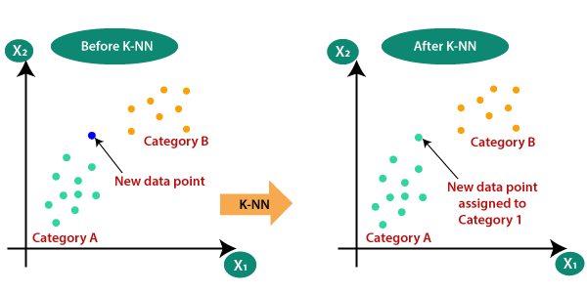




Slide 5
Step-1: Select the number K of the neighbors
Step-2: Calculate the Euclidean distance of K number of neighbors
Step-3: Take the K nearest neighbors as per the calculated Euclidean distance.
Step-4: Among these k neighbors, count the number of the data points in each category.
Step-5: Assign the new data points to that category for which the number of the neighbor is maximum.
Step-6: Our model is ready.

Slide 6
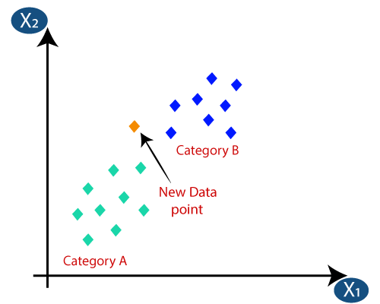
Suppose we have a new data point and we need to put it in the required category.

Slide 7
Firstly, we will choose the number of neighbors, so we will choose the k=5.
Next, we will calculate the Euclidean distance between the data points.
The Euclidean distance is the distance between two points, which we have already studied in geometry.
It can be calculated as:

Slide 8
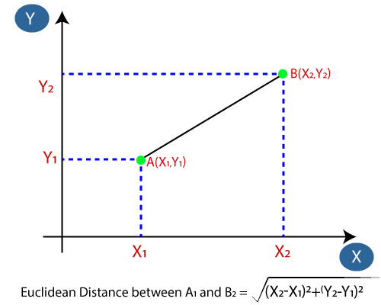

Slide 9
As we can see the 3 nearest neighbors are from category A, hence this new data point must belong to category A.

Slide 10
Advantages
It is simple to implement.
It is robust to the noisy training data
It can be more effective if the training data is large.

Slide 11
Disadvanatges
Always needs to determine the value of K which may be complex some time.
The computation cost is high because of calculating the distance between the data points for all the training samples.

Slide 12
Exercise
From sklearn.datasets load digits dataset and do following
1. Classify digits (0 to 9) using KNN classifier. You can use different values for k neighbors and need to figure out a value of K that gives you a maximum score.
1. Plot confusion matrix
1. Plot classification report

Slide 13
Classification Report
Metrics | Definition
Precision | Precision is defined as the ratio of true positives to the sum of true and false positives.
Recall | Recall is defined as the ratio of true positives to the sum of true positives and false negatives.
F1 Score | The F1 is the weighted harmonic mean of precision and recall. The closer the value of the F1 score is to 1.0, the better the expected performance of the model is.
Support | Support is the number of actual occurrences of the class in the dataset. It doesn’t vary between models, it just diagnoses the performance evaluation process.

